Slide 1
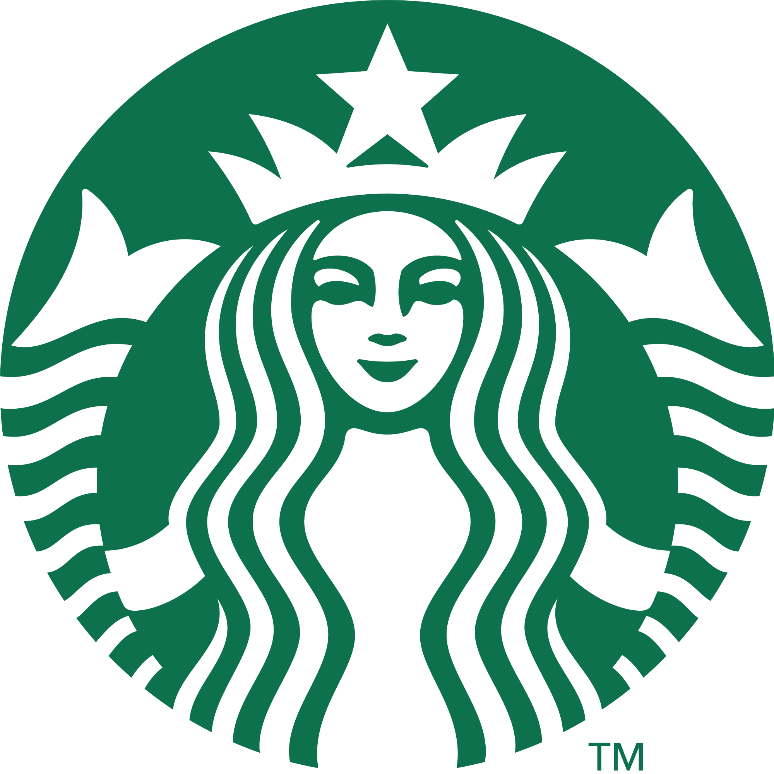
Starbucks
Financial Analysis of Starbucks
Group Members:
Teimuraz Kometiani
Teimuraz Kuliashvili
Nikoloz Matsaberidze
Tengizi Giorgadze
Konstantine Machavariani
Demetre Labadze

Slide 2
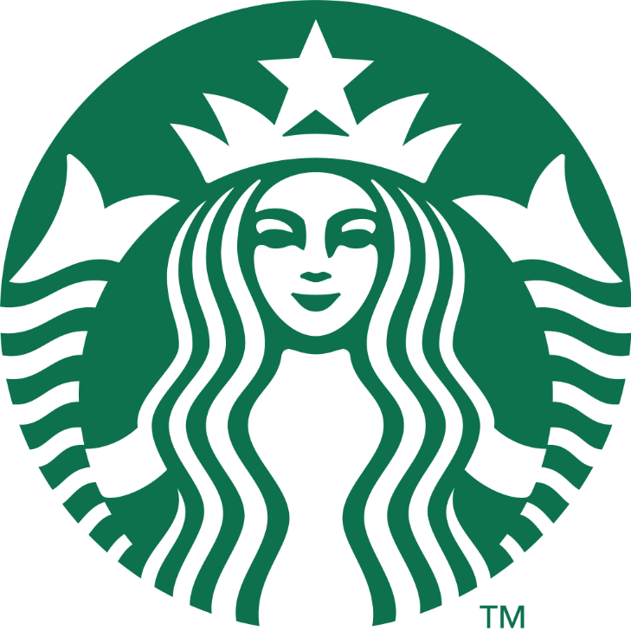
Company Overview
Founded in 1971, in Seattle, Washington
Offers premium coffee, tea, and food
Founders: Jerry Baldwin, Zev Siegl, and Gordon Bowker
Operates in over 80 countries with 35,000+ stores
Leading global coffeehouse chain and roastery.

Slide 3
Company Activities
Offers premium coffee, tea, and food
Founded in 1971, in Seattle, Washington
Operates in over 80 countries with 35,000+ stores
Founders: Jerry Baldwin, Zev Siegl, and Gordon Bowker
Operational Activities
Selling Coffee Managing Stores Supply Chain Activities Employee Operations
Non-Operational Activities
Investments Non-core assets income Share Repurchases
Leading global coffeehouse chain and roastery.

Slide 4
Business Overview
Operational Activities
Selling Coffee Managing Stores Supply Chain Activities Employee Operations
Non-Operational Activities
Investments Non-core assets income Supply Chain Activities Employee Operations
Subsidiaries
Starbucks Coffee | Ethos Water | La Boulange Bakery | Teavana

Slide 5



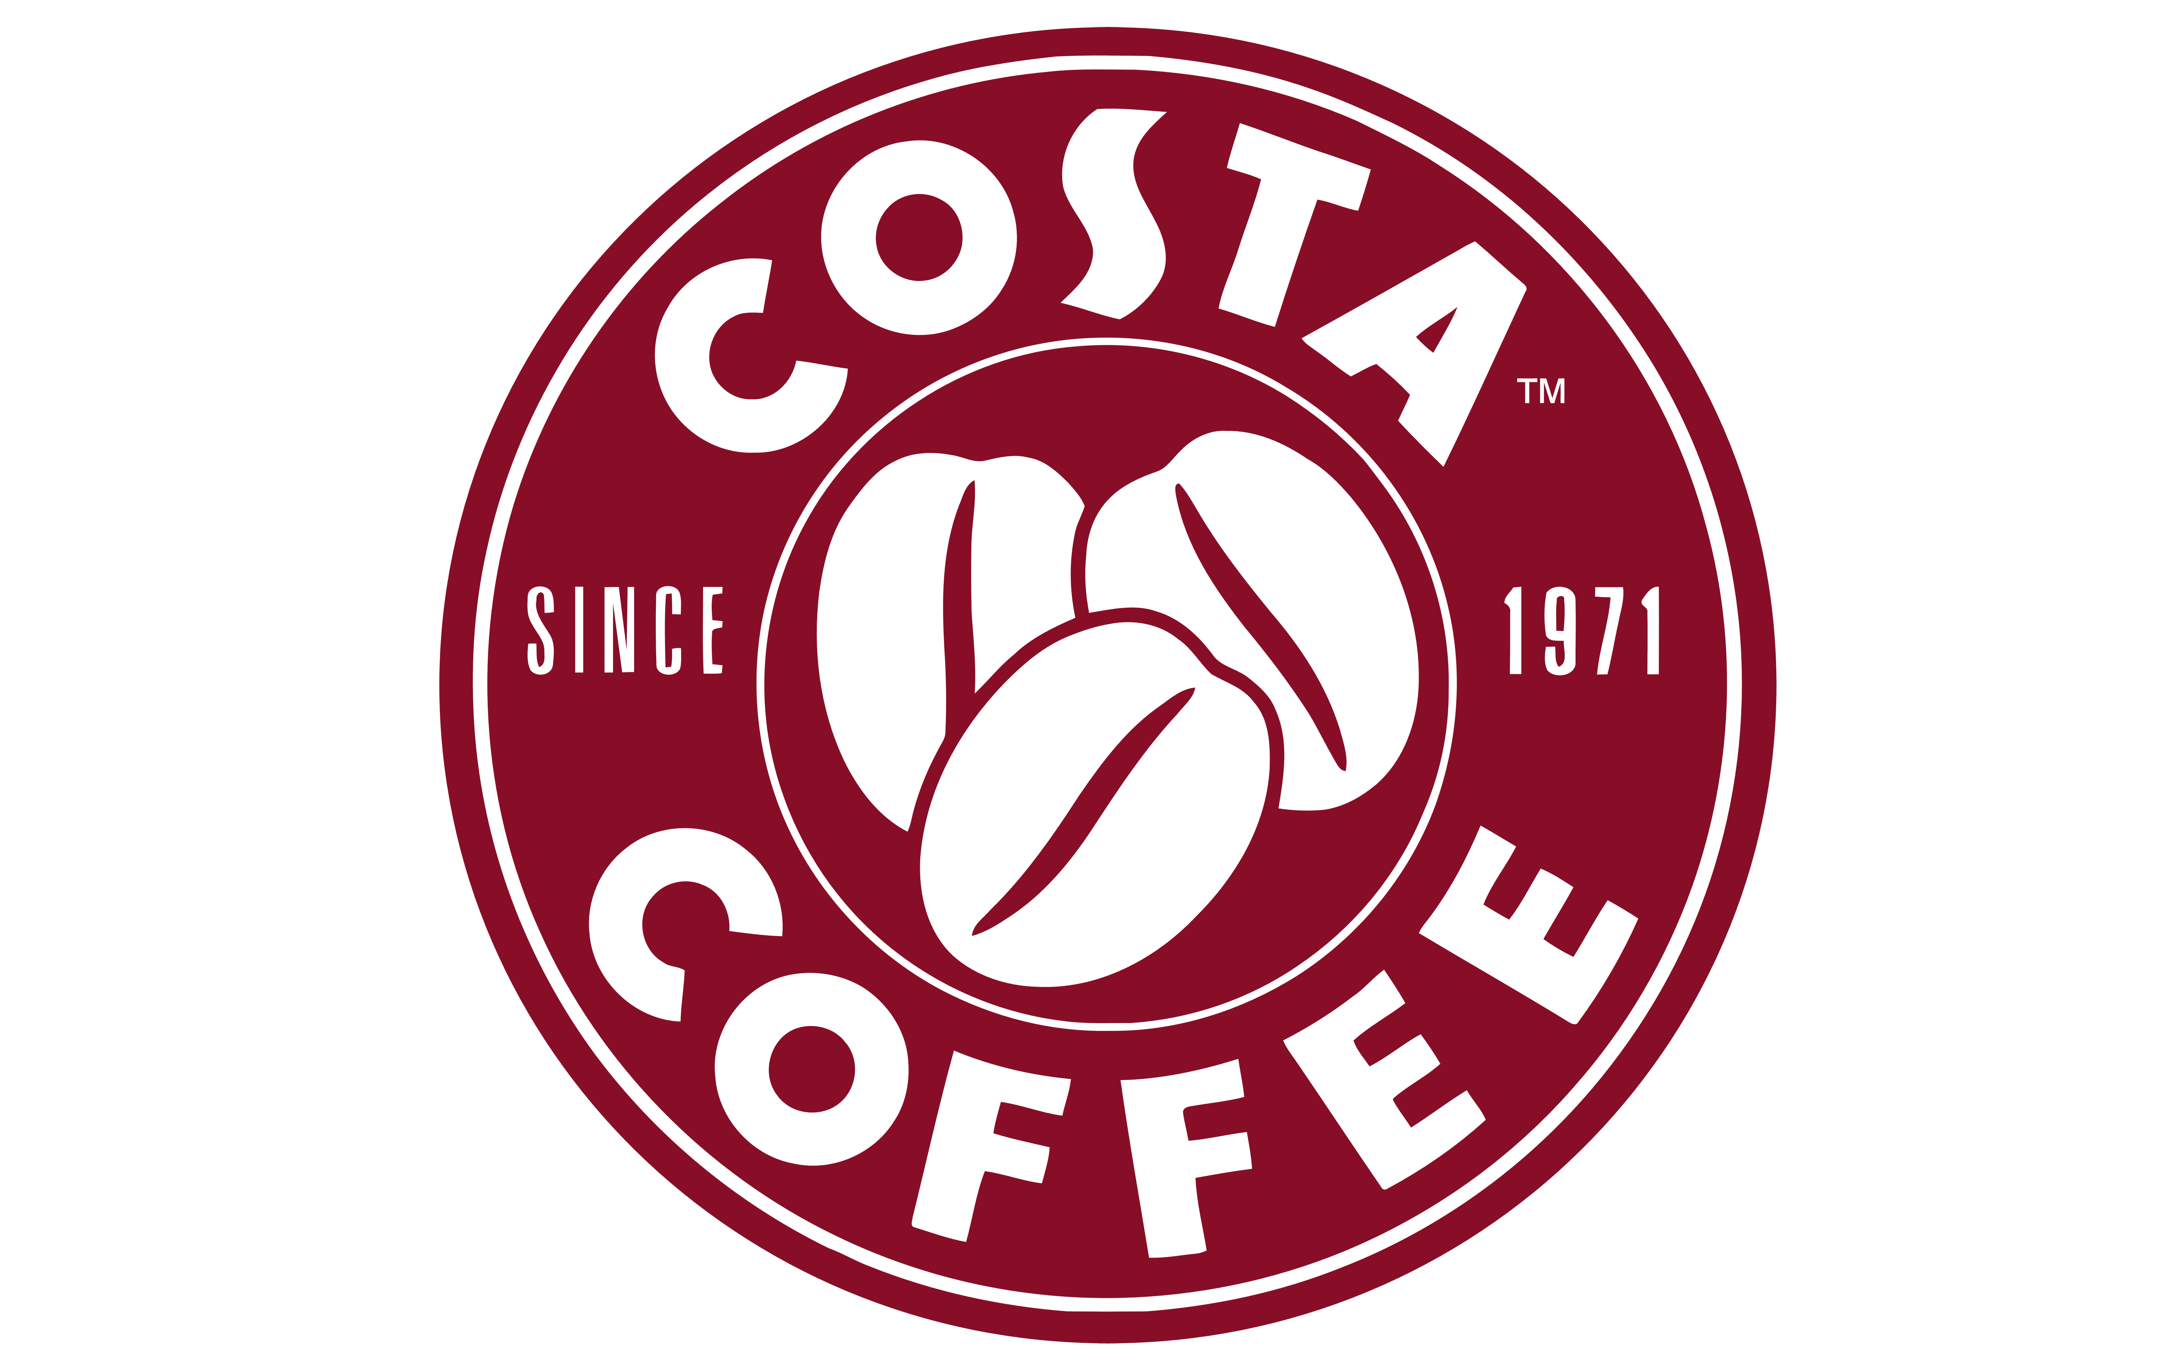
Business Overview
Competitors
Dunkin Brands | McDonald | Costa Coffee | Tim Hortons
Starbucks Coffee | Ethos Water | La Boulange Bakery | Teavana

Slide 6
Starbucks Total Valuation
Starbucks has a market cap or net worth of $110.45 billion. The enterprise value is $132.73 billion.

Slide 7
Revenue by Sector

Slide 8
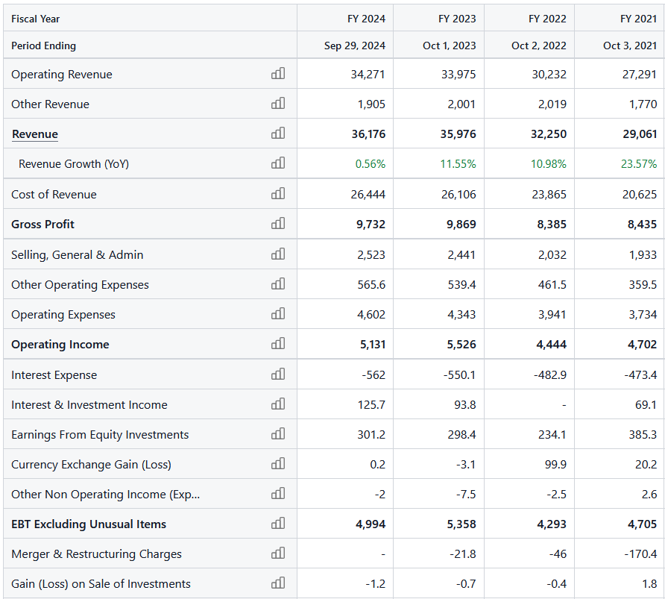
Income Statement Analysis
…
*note full income statement is multi paged and would be impossible to fit in presentation. You can see full version here.

Slide 9
Income Statement Analysis

Slide 10
Income Statement Analysis
Revenue grew from $29.06B in 2021 to $36B in 2023, reflecting consistent expansion and increased demand
Gross Profit recovered to $9.87B in 2023 after a dip in 2022, indicating improved efficiency and cost management
Net Income rebounded to $4.12B in 2023 from $3.28B in 2022, driven by effective expense control and revenue growth
EPS improved to $3.58B in 2023, showcasing increased value for 2022's challenges
EBITDA steadily rose to $6.98B in 2023, reflecting ability to strengthen profitability

Slide 11
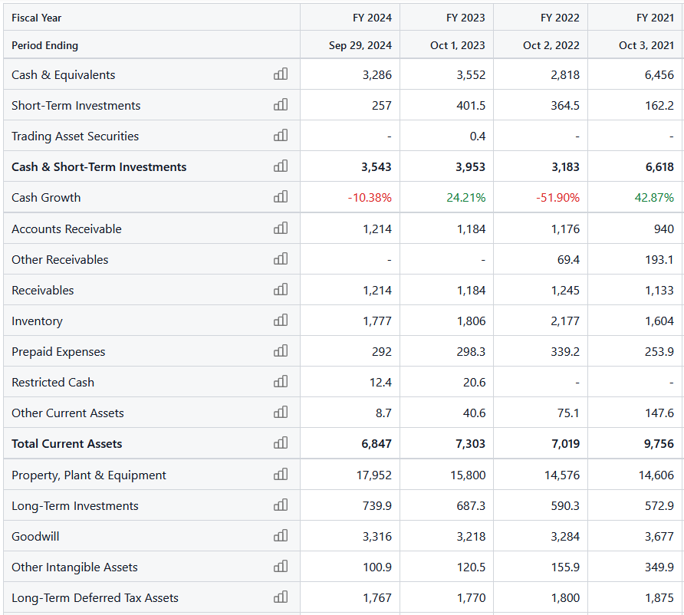
Balance Sheet Analysis
…
*note full balance sheet is multi paged and would be impossible to fit in presentation. You can see full version here.

Slide 12
Balance Sheet Analysis
-7.99
-5.31
-8.7
Starbucks has strategically leveraged debt for expansion, leading to rising liabilities and negative shareholder equity. However, the company has sustained growth in assets and profitability, with fluctuations in global investments and operational efficiency, positioning Starbucks for future growth while managing financial risk.

Slide 13
Balance Sheet Analysis
Starbucks has strategically leveraged debt for expansion, leading to rising liabilities and negative shareholder equity. However, the company has sustained growth in assets and profitability, with fluctuations in global investments and operational efficiency, positioning Starbucks for future growth while managing financial risk.

Slide 14
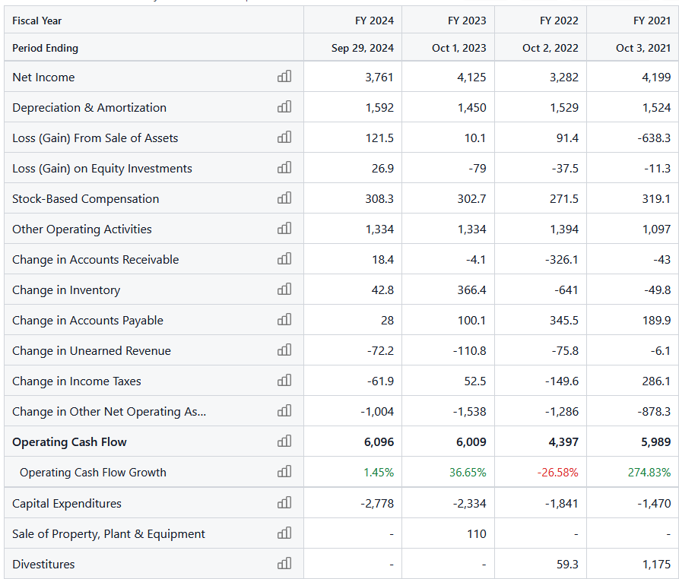
Cash Flow Statement Analysis
…
*note full cash flow statement is multi paged and would be impossible to fit in presentation. You can see full version here.

Slide 15
Cash Flow Statement Analysis
Starbucks demonstrates strong operating cash flow, supporting its business activities.
Negative investing cash flow reflects strategic long-term investments, while fluctuating financing cash flow shows focus on shareholder returns and debt management.
Overall, Starbucks maintains a solid financial position, balancing expansion with shareholder value.

Slide 16
Cash Flow Statement Analysis
Starbucks demonstrates strong operating cash flow, supporting its business activities.
Negative investing cash flow reflects strategic long-term investments, while fluctuating financing cash flow shows focus on shareholder returns and debt management.
Overall, Starbucks maintains a solid financial position, balancing expansion with shareholder value.

Slide 17
Financial Ratios
Profitability Ratios
 | 2023 | 2022 | 2021
Gross Profit Margin | 27.43% | 26.00% | 29.05
EBITDA | 18.58% | 19.39% | 18.52%
Return on Capital (ROIC) | 21.72% | 16.61% | 16.41%
Return on Assets (ROA) | 12.03% | 9.36% | 9.67%
Notes:
Gross Profit Margin = (Net Profit / Revenue) * 100% EBITDA Margin = (EBITDA / Revenue) * 100% Earnings Before Interest, Taxes, Depreciation and Amortization.

Slide 18
Financial Ratios
Profitability Ratios
In 2023, Starbucks improved profitability and efficiency with a Gross Profit Margin of 27.4%, stable EBITDA at 18.58%, and higher ROIC and ROA. These gains reflect better capital and asset utilization, positioning the company for sustainable growth compared to 2022 and 2021 levels.
Notes:
Gross Profit Margin = (Net Profit / Revenue) * 100% EBITDA Margin = (EBITDA / Revenue) * 100%

Slide 19
Financial Ratios
Profitability Ratios
In 2023, Starbucks improved profitability and efficiency with a Gross Profit Margin of 27.4%, stable EBITDA at 18.58%, and higher ROIC and ROA. These gains reflect better capital and asset utilization, positioning the company for sustainable growth compared to 2022 and 2021 levels.

Slide 20
Financial Ratios
Liquidity Ratios
The company's liquidity has weakened over the past three years, with both the Quick Ratio and Current Ratio declining.
The Quick Ratio has remained below 1.0 since 2022, indicating potential difficulty in meeting short-term obligations, while the Current Ratio has also decreased, signaling tightening liquidity.
 | 2023 | 2022 | 2021
Quick Ratio | 0.55 | 0.48 | 0.95
Current Ratio | 0.78 | 0.77 | 1.20
Notes:
Quick Ratio = (Cash + Short-Term Investments + Accounts Receivable) / Current Liabilities,
Current Ratio = Current Assets / Current Liabilities

Slide 21
Financial Ratios
Liquidity Ratios
The company's liquidity has weakened over the past three years, with both the Quick Ratio and Current Ratio declining.
The Quick Ratio has remained below 1.0 since 2022, indicating potential difficulty in meeting short-term obligations, while the Current Ratio has also decreased, signaling tightening liquidity.

Slide 22
Financial Ratios
Solvency Ratios
Starbucks shows negative Debt-to-Equity and Interest Coverage ratios across the past three years, indicating a reliance on debt beyond its equity and limited ability to cover interest expenses with earnings. These trends highlight potential solvency concerns and the need for improved debt management.
 | 2023 | 2022 | 2021
Debt-to-Equity | -3.08 | -2.74 | -4.44
Interest Coverage | -10.05 | -9.21 | -9.93
Notes:
Interest Coverage = EBIT / Interest Expense

Slide 23
Financial Ratios
Solvency Ratios
Starbucks shows negative Debt-to-Equity and Interest Coverage ratios across the past three years, indicating a reliance on debt beyond its equity and limited ability to cover interest expenses with earnings. These trends highlight potential solvency concerns and the need for improved debt management.

Slide 24
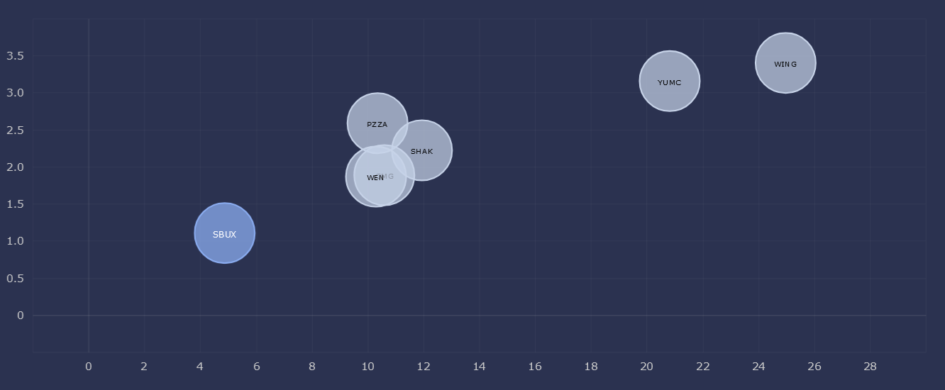
Deviation Analysis
Starbucks has standard deviation of 1.1
Starbucks is rated below average in standard deviation category among its peers.
Notes:
SQRT = Square root notation V = Variance of Starbucks returns

Slide 25
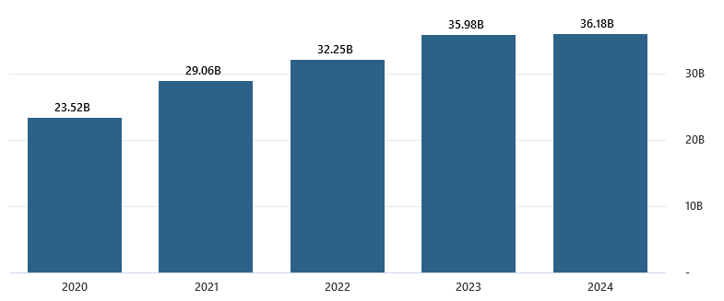
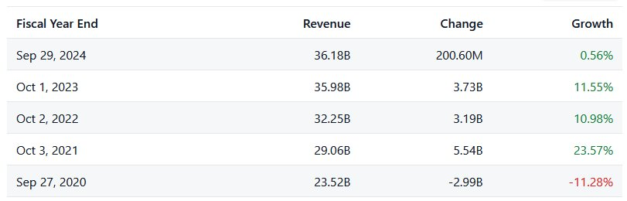
Performance Analysis
Revenue Growth
Revenue grew steadily from $29.1B in 2021 to $36.0B in 2023, thanks to a strong recovery and better pricing strategies. The company’s market value also increased, reflecting investor confidence in its consistent growth and operations.

Slide 26
Performance Analysis
Revenue Growth
Revenue grew steadily from $29.1B in 2021 to $36.0B in 2023, thanks to a strong recovery and better pricing strategies. The company’s market value also increased, reflecting investor confidence in its consistent growth and operations.

Slide 27
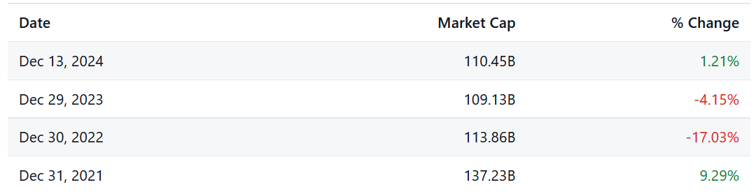
Performance Analysis
Market Cap

Slide 28
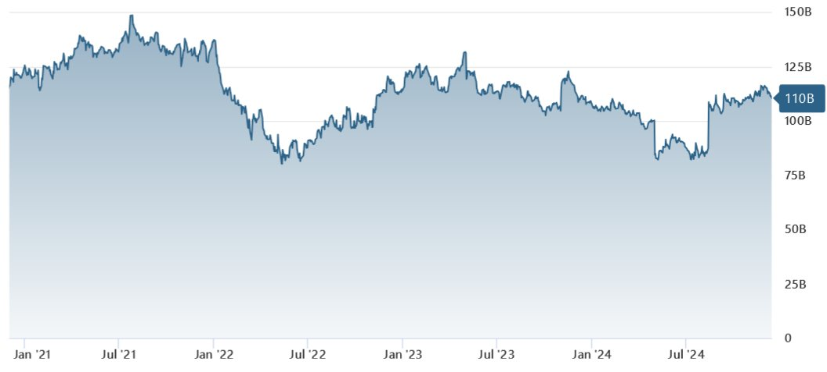
Performance Analysis
Market Cap
Starbucks consistently expanded its store count from 2022 to 2023, with a 6% average growth each quarter. Reflecting a strong global expansion strategy and sustained demand.

Slide 29
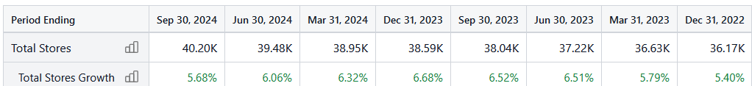
Performance Analysis
Stores Growth
Starbucks consistently expanded its store count from 2022 to 2023, with a 6% average growth each quarter. Reflecting a strong global expansion strategy and sustained demand.

Slide 30
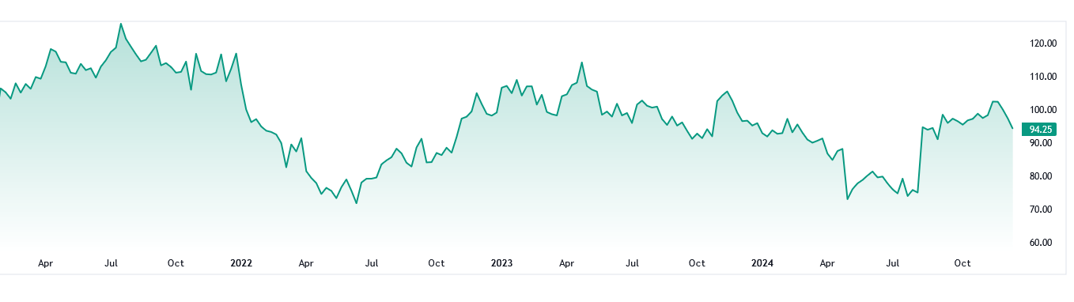
Performance Analysis
Stores Growth
SBUX Chart

Slide 31
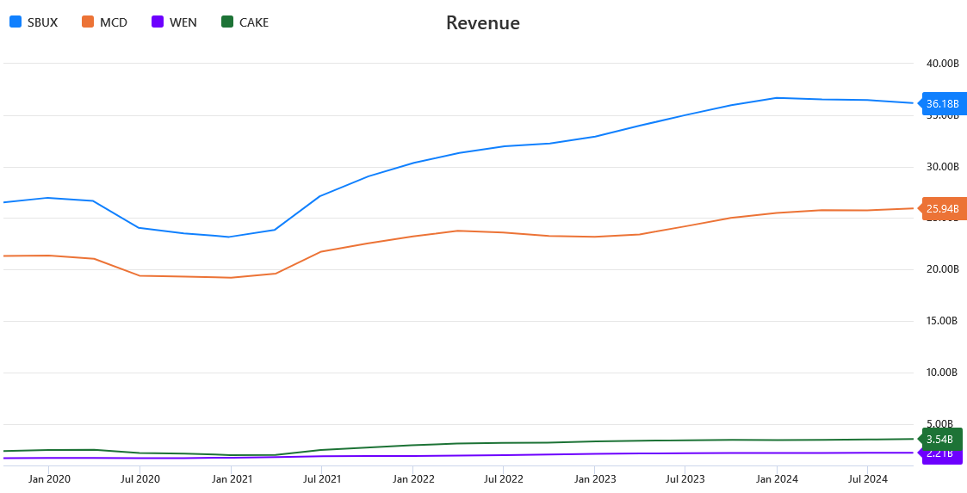
Benchmark Analysis

Slide 32
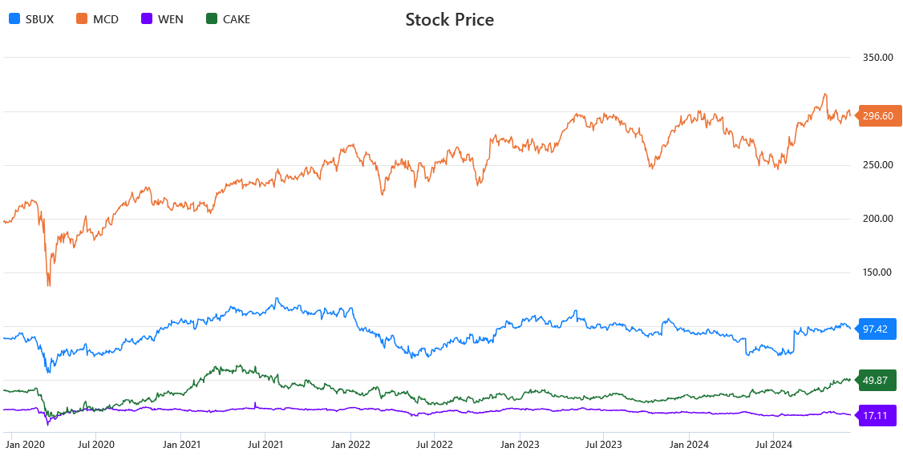
Benchmark Analysis

Slide 33
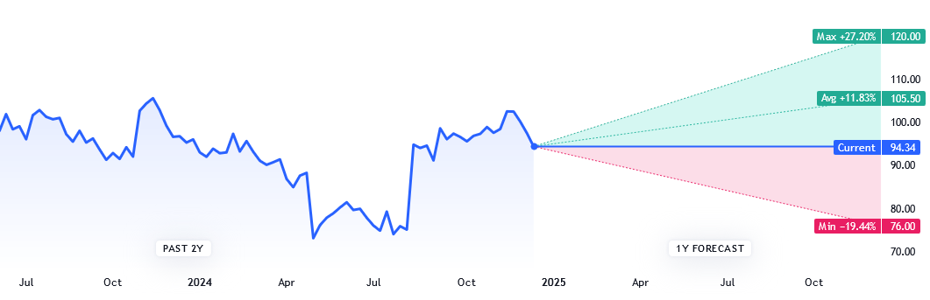
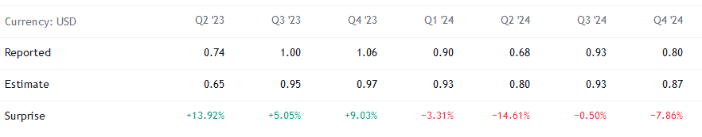
Forecast Analysis
Starbucks Stock Forecast

Slide 34
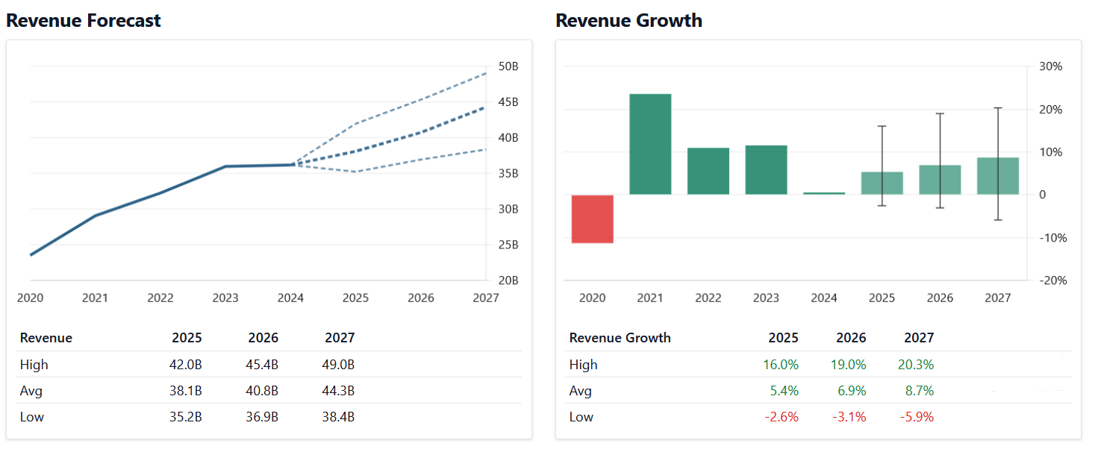
Forecast Analysis

Slide 35
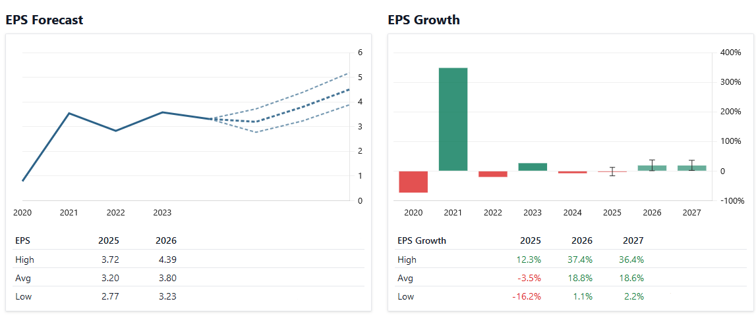
Forecast Analysis
Notes:
EPS = (Net income – Preferred Dividends)/Outstanding Shares

Slide 36
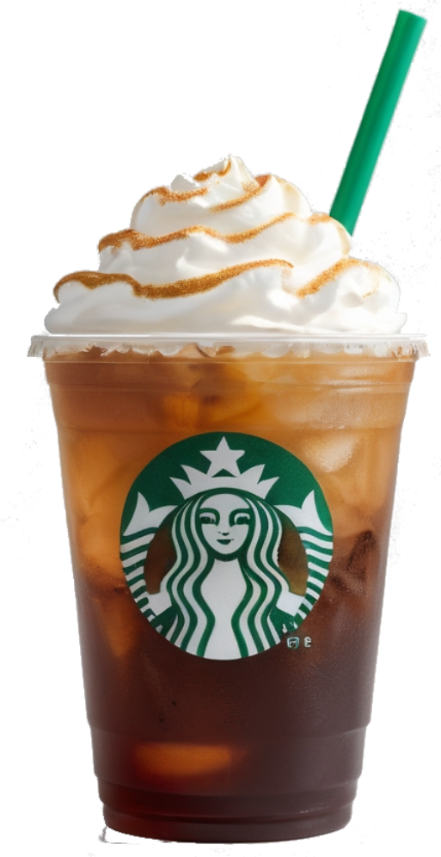
Starbucks Position
Starbucks maintains a strong market position as a global leader in the coffee industry and customer loyalty. From 2021 to 2023, revenue increased from $29.1B to $36B, reflecting post-pandemic recovery and global expansion. Along with record gross profit of $9.87B, boosted investor confidence, positively influencing stock price momentum.

Slide 37



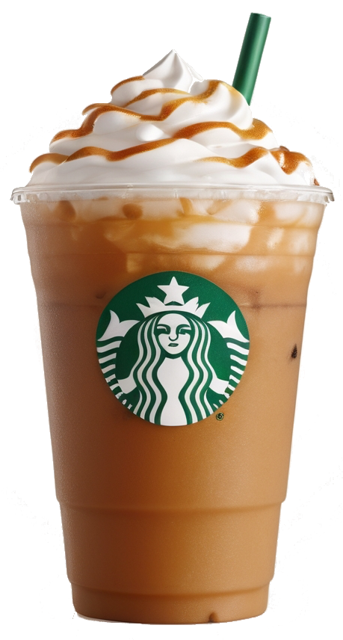


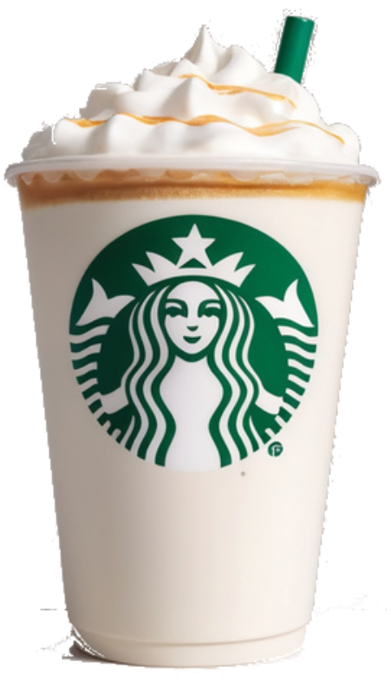
SWOT Analysis
Starbucks maintains a strong market position as a global leader in the coffee industry and customer loyalty. From 2021 to 2023, revenue increased from $29.1B to $36B, reflecting post-pandemic recovery and global expansion. Along with record gross profit of $9.87B, boosted investor confidence, positively influencing stock price momentum.
S
Strong brand, innovation, sustainability, and digital engagement drive loyalty
Competition, costs, limited options hinder growth
W
Expansion, new items, and partnerships drive growth
Competition, supply chain, economy and labor risks
O
T

Slide 38
Should you Invest?
S
Strong brand, innovation, sustainability, and digital engagement drive loyalty
Competition, costs, limited options hinder growth
W
Expansion, new items, and partnerships drive growth
Y E S
O
Competition, supply chain, economy and labor risks
T
Invest in Starbucks for strong growth, brand, and efficiency, despite risks. Predictions showing 11.55% stock price increase, with a target of $103.88

Slide 39
Should you Invest?
THANK YOU FOR YOUR ATTENTION
Y E S
Invest in Starbucks for strong growth, brand, and efficiency, despite risks. Predictions showing 11.55% stock price increase, with a target of $103.88

Slide 40
Should you Invest?
THANK YOU FOR YOUR ATTENTION
Y E S
Invest in Starbucks for strong growth, brand, and efficiency, despite risks. Predictions showing 11.55% stock price increase, with a target of $103.88

Slide 41
Sources
Main Page
Operations
Wiki
Subsidiaries
Competitors
Revenues by Segment
Income Statement
Balance Sheet
Cash Flow
Ratios
Deviation
Revenue
Market Cap
Stores Growth
Stock Chart
Stock Comparison
Forecast
Why invest?

